Slide 1
Machine Learning – Lecture 3

Slide 2
Machine Learning Project
Supervised Learning
Unsupervised Learning
Classification

Slide 3
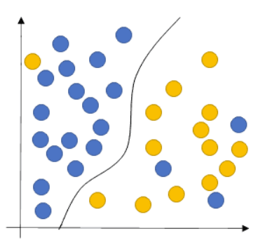
Supervised Learning
Traffic Classification based on a specific label
Our goal is to learn a function that, given a sample of data and desired outputs, best approximates the relationship between input and output observable in the data

Slide 4
Starting from Literature
Our starting point is a work implemented in 2010 :
D. Rossi, S. Valenti - ”Fine-grained traffic classification with Netflow data”
They present an algorithm (Abacus) which successfully exploits Netflow records for traffic classification. Identifying an application by means of the simple counts of received packets and bytes.

Slide 5
Classification methodology
Data:
Netflow measures flow level features
What is a flow ?
Key (5-tuple)= <IP src, IP dst, src Port, dst Port, IP Protocol>
The key identifies a record in memory, storing besides attributes like cumulative packets and bytes counters, flow starting and finishing timestamps.

Slide 6
Classification methodology
Goal: Abacus classifies application endpoints (IP0,p0), focusing the attention on UDP Traffic.
Classes: [Pplive, TVAnts, SopCast, Joost, Edonkey, BitTorrent, Skype, DNS]
The idea is based on the behavioral classification, but it is the first fine-grained classification engine identifying the traffic by the sole examination of their traffic patterns (light-weight approach)

Slide 7
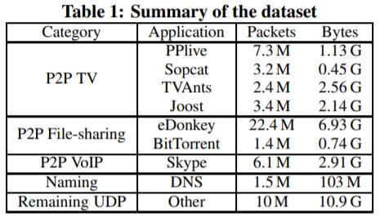
Dataset Description

Slide 8
Classification methodology
IP_{i} , p_{i}
C
IP_{i} , p_{i}
C
IP₀ , p₀
C
IP_{i} , p_{i}
ΔT
The classification is based on the raw count of packets and bytes
received by (IP₀, p₀) from the set C = {(IP_{i}, p_{i})} of N neighboring endpoints
(during an interval ∆T)

Slide 9
Classification methodology
Vector Representation:
They evaluate the distribution of «P-packets» and «B-bytes» representig them as |p| = 1 and |b| = 1
In both distributions is applied the log₂ binning, highlighting the differences for lower counts of packets and bytes
Abacus signatures s:= (p,b)
This represents the training data for the SVM algorithm

Slide 10
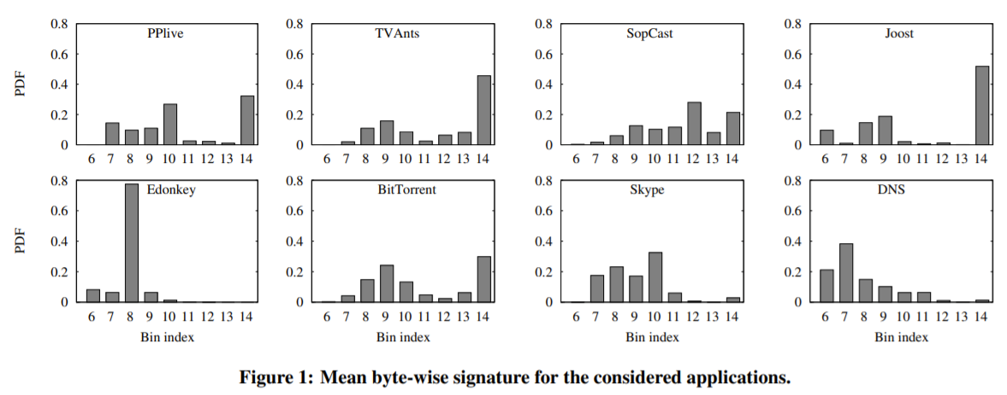
Differentiation between classes

Slide 11
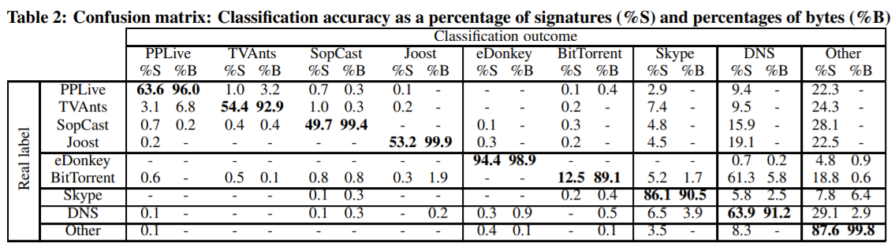
Accuracy Results
Can we replicate this proposal with our own project ?
It’s time to work …

Slide 12
Machine Learning – Code

Slide 13
Project Idea
Replicate supervised work with a different label → DSCP
DSCP stands for Differentiated Services Code Point
The architecture is called DiffServ and its purpose is to improve the QoS in IP traffic with optimal scalability.
It relies on a mechanism to classify packets as belonging to a specific service class (SC).

Slide 14
DiffServ Label
*(DS Field – 8 bits)→ DSCP(6) + ECN(2)
DSCP Value | DSCP Class | Class Label
48,56 | CS6, CS7 | Network & InterNet Control
40,46 | CS5, EF | Critical Voice RTP
32, 34, 36, 38 | CS4, AF4 | Flash Override
24, 26, 28, 30 | CS3, AF3 | Flash Voice
16, 18, 20, 22 | CS2, AF2 | Immediate
8, 10, 12, 14 | CS1, AF1 | Priority
0 | CS0 | Best Effort

Slide 15
Project Idea
In our project we exloit this label but in a summarized way:
Best Effort (BF)
Scavenger (called NotKnow in the code)
Assured Forwarding (AF)
Expedited Forwarding (EF)
Network & Internetwork control (NIC)
Dataset: https://mawi.wide.ad.jp/mawi/samplepoint-G

Slide 16
Machine Learning Code
Code Link : https://github.com/davaureli/NBD_LabSession
Lecture Folder: Lecture 3

Slide 17
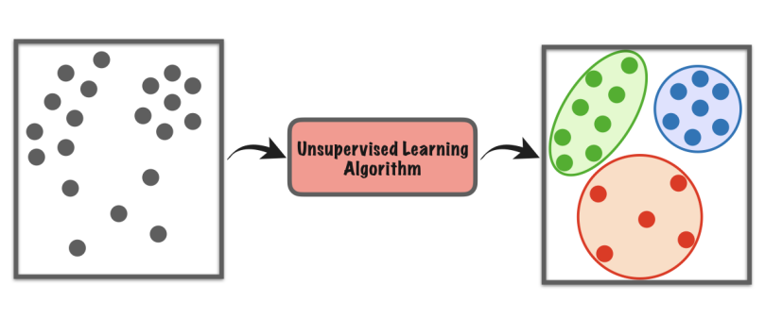
Unsupervised Learning
Traffic Classification based on unlabelled data
The model works to discover patterns and information that was previously undetected

Slide 18
Starting from Literature
Our starting point is a work implemented in 2009 :
Y. Zeng, T.M. Chen - ” Classification of Traffic Flows into QoS Classes by Unsupervised Learning and KNN Clustering”
They use K-means clustering as unsupervised machine learning methods to identify the inherent classes in traffic traces.

Slide 19
Dataset
Data: The traffic was separated into flows by the quintuplet {IP Src, IP Dst, Protocol, src-port, dst-port}
Applications: HTTP, FTP, DNS, telnet
Idea: Traffic flows are classified into QoS classes, flows within the same QoS class share similar service requirements

Slide 20
Variables
Candidate Feature:
• packet level: packet length statistics (max, min,μ,var);
• flow level: statistics of number of packets per flow, number of bytes per flow, flow duration, interarrival times;
• TCP connection level: statistics of packets per TCP connection, bytes per connection, connection duration

Slide 21

K-Means
K-Means finds the optimal solution by minimizing the square distance:
K:# clusters
c: # centroids
n:items
Working without «a priori» knowledge about the optimal number of clusters (k), it is determined by the elbow method analysis.
The optimal number of centroids minimizes the sum of distance

Slide 22
Fast view on results
Discovered 3 clusters: DNS , Telnet and FTP control, HTTP.
DNS → small avg packet size,
short connection duration time
Telnet and FTP control → small avg packet size,
long connection duration
HTTP → medium/large avg packet size,
low/medium connection duration

Slide 23
From clusters to QoS Class
In the last analysis the authors observed that the K-Means results replicate the applications differentiation based on QoS requirements provided by Roughan et al[1]
[1]Roughan et al, “Class-of-service mapping for QoS: a statistical signature-based approach to IP traffic classification,”
Application | QoS Class
DNS | Transactional
Telnet and FTP control | Interactive
HTTP | Bulk transfer

Slide 24
Final Project

Slide 25
Project Assignment (Dataset)
Data:
https://drive.google.com/drive/folders/1YMwwPoekwJrw_-UYkZYUkTFqC8bqAy0F?usp=sharing
This dataset is provided by the Mawi Project, the total amount of the trace is 5Mln of packets retrieved from the traffic trace of 10/04/2019.
(https://mawi.wide.ad.jp/mawi/samplepoint-G/2019/201904101400.html)

Slide 26
Project Assignment
Extract 1 million of packets from the available data, replicate the statistical analysis observed during Lecture 2. FOLLOW the LIST!
Extract general info from your trace using capinfos;
Time Evaluation between Sequential and Parallel reading;
Extract the IP which generates the highest amount as sender traffic, evaluate the bit rate (0.1 sec) for the 6 IP addresses mostly used as endpoint
Top 5 Destination IP (received bytes) and Top 5 Source IP (sent bytes)

Slide 27
Project Assignment
5) Evaluate bitRate considering all the trace with 3 different sampling rate
6) GeoLocal Referenciation of the 5 sessions with the highest amount of traffic generated;
7) 10 Protocol mostly used;
8) Port Scanner evaluation (10 Ports mostly used);
9) InterArrival Time boxplot between TCP and UDP Sessions;

Slide 28
Project Assignment
10) Develope your own analysis (e.g. Topology of the network using networkx or evaluation about a variable such as TTL) (BONUS)

Slide 29
Project Assignment
B) Using the same dataset, you can cut the time interval as you want trying to replicate or Supervised or Unsupervised classification problem.
Summarizing results according to the accuracy and other metrics related to the label(**) considered, you can add the more variables w.r.t. the paper analyzed but remember you must work with flow based features.
**You can both replicate DSCP analysis or change the label for example classify TCP and UDP. You have complete freedom about the label and the algorithm for classification

Slide 30

Thank you for your attention !
Mail: davide.aureli@uniroma1.it

